Slide 1

Benefits from FDOC Generic Promotion on the Demand for Orange Juice
Presentation to the Florida Citrus Commission
December 12, 2022
LISA HOUSE, Professor and Chair
Prepared with Dr. Yan Heng and Dr. Sungeun Yoon, UF, FAMRC
FOOD AND RESOURCE ECONOMICS DEPARTMENT

Slide 2
FDOC ROI Analysis
Method 1
Method 2
Household Tracker Data (UF)
Store Audit
Data (Nielsen)
Buyers Model
(Market Penetration)
Volume Model
(Market Intensity)
Volume Model
(Market Intensity)
©2022 Florida Agricultural Market Research Center

Slide 3

Demand Drivers
Demand drivers include
  Demographics
  Perceived benefits and risks
  Promotions and advertising
  Market shocks (e.g., Covid-19, inflation)
  Other
Demand
Drivers
OJ Demand
©2022 Florida Agricultural Market Research Center

Slide 4
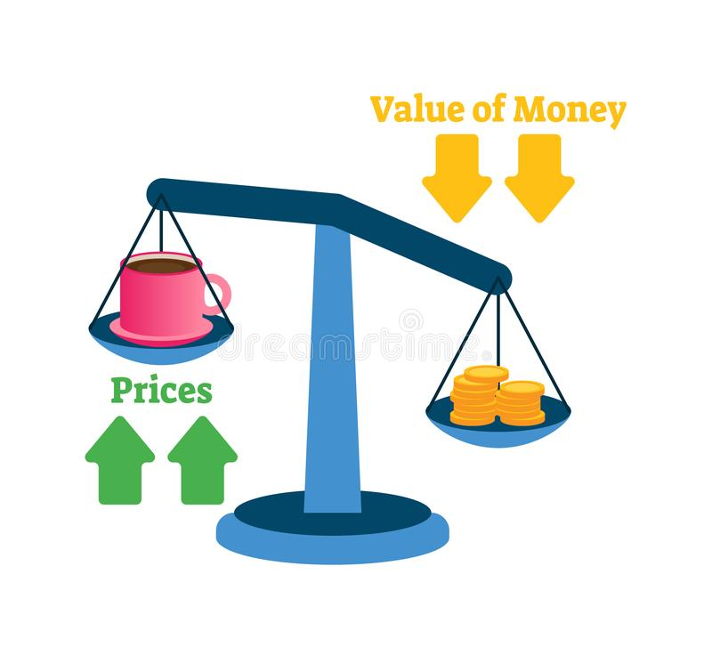
US Inflation Rate
Note: 2022 rate is to-date, it is expected to be closer to 6-7% by end of year
Expectations for 2023 are closer to 3%
(expectations are not perfect)
https://www.usinflationcalculator.com/inflation/current-inflation-rates/
©2022 Florida Agricultural Market Research Center

Slide 5
Do consumers notice?
Consumer agreement with "I have noticed an increase in food prices at my grocery store recently"
©2022 Florida Agricultural Market Research Center

Slide 6
Intensity of price awareness
Strongly Agree
Consumer agreement with "I have noticed an increase in food prices at my grocery store recently"
©2022 Florida Agricultural Market Research Center

Slide 7
Consumer spending on groceries (average weekly per household member)
©2022 Florida Agricultural Market Research Center

Slide 8
Agreement with Good Attribute Statements
Scale 1-7: A rating of greater than 5 is considered as Agree
©2022 Florida Agricultural Market Research Center

Slide 9
Enhanced Perception of Health/Nutritional Benefits of OJ
©2022 Florida Agricultural Market Research Center

Slide 10
Awareness of Promotions and Media Mentioning about OJ
Promotion: Do you recall hearing or seeing any mention of promotion or advertisement for OJ during the past 30 days?
Media: Have you seen, heard or read anything about OJ anywhere in the past 30 days?
©2022 Florida Agricultural Market Research Center

Slide 11
Awareness of Florida 100% OJ logo
Have you seen any logos for 100% Orange Juice that is from Florida, either in advertising ,
promotions, or on a container in the past 30 days?
©2022 Florida Agricultural Market Research Center

Slide 12
Awareness of Florida Enhance Consumers’ Good Perception on OJ and Shopping Frequency
©2022 Florida Agricultural Market Research Center

Slide 13



Enhanced Perception of Health/Nutritional Benefits of OJ
On average, 47% of the households in the tracker purchased OJ in the past 30 days
If we set awareness to 0, we predict only 42% would purchase OJ (likewise, if we increase the awareness, we will increase the percent purchasing)
©2022 Florida Agricultural Market Research Center

Slide 14
Impact of Promotion Awareness on Volume
111.14 mil gallons
20.21 million boxes
©2022 Florida Agricultural Market Research Center

Slide 15
ROI Table
 | Units | Household tracker |  | Nielsen Data | Nielsen Data (85%)
FDOC promotion expenditure | million $ | $11.6 3-year average ($19.2 in 2021-22FY)
Estimated retail quantity sales with promotion | million SSE Gallon | 982.34 |  | 414.43 | 487.56
Estimated retail quantity sales without promotion | million SSE Gallon | 871.20 |  | 328.76 | 386.78
Increased retail quantity sales | million SSE Gallon | 111.14 |  | 85.67 | 100.79
 |  | Reported price | Nielsen price
Retail Price | $/Gallon | $7.94 | $7.73 | $7.73 | $7.73
Gain in retail revenue | million $ | $882 | $859 | $662 | $779
Markup down (delivered-in/retail price) | % | 27.0%
Gain in delivered-in (producer) revenue | million $ | $238 | $232 | $179 | $210
Domestic share of total available OJ | % | 28% (2021-22 Producer share)
Gain to Florida producers | million $ | $66.7 | $65.0 | $50.0 | $58.9
ROI (delivered-in to domestic juice) |  | 5.75 | 5.60 | 4.32 | 5.08
Net ROI (delivered-in to domestic juice) |  | 4.75 | 4.60 | 3.32 | 4.08
©2022 Florida Agricultural Market Research Center

Slide 16
What key variables influence ROI?
ROI is calculated by dividing Gains to Florida producers by current year promotion expenditures
  Sudden changes in promotion expenditures may cause large changes in ROI because it takes time for marketing investment to build results (for example, we consider lag effects – the impact of past investment on current sales, and this is ignored for current investment)
  Changes in domestic share of OJ can cause larger changes as ROI is calculated on increase in sales attributed to awareness based on domestic share
©2022 Florida Agricultural Market Research Center

Slide 17
Thank you

