Slide 1
A behind-the-scenes dive into how it all works, with Edible
FDOC eCommerce & Driving Florida Orange Juice Sales:
January 13, 2022

Slide 2

Introduction – Why We’re Here Today
Meredith Nelson, Senior Vice President
Edelman Performance Intelligence
Today’s Agenda:
Consumer Behavior
Path to Purchase
Lapsed Buyer Audience
Retail Partners
Budget Optimizations

Slide 3
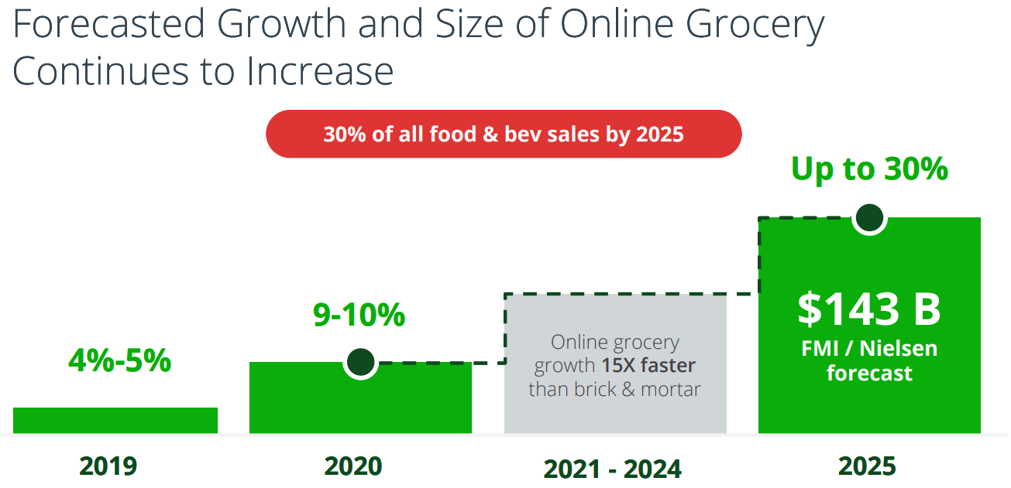

Shifting Consumer Behaviors
Shifts in grocery shopping behavior make consumer engagement on eCommerce more important than ever.
Nielsen data indicates that online grocers’ market share will only continue to increase -- +233% between 2020 and 2025.

Slide 4
Core Plan Principles For Success
1
2
3
Always Monitor
Be Nimble
Optimize

Slide 5















FY21-22 Plan Overview
Encourage Consumer loyalty to keep coming back to FLOJ retargeting tactics.
Repeat
Purchase
Drive preference of Florida Orange Juice by educating consumers on the Florida Difference.
Awareness
Post
Purchase
Ensure Florida Orange Juice is top of mind during post-purchase evaluation.
Consideration
Increase Traffic to FDOC’s Retailer Landing Page to encourage users to purchase.
Purchase
Meet Consumers where they are shopping for OJ and similar goods to drive incremental purchases.
5

Slide 6
Focusing in on Purchase
Encourage Consumer loyalty to keep coming back to FLOJ retargeting tactics.
Repeat
Purchase
Drive preference of Florida Orange Juice by educating consumers on the Florida Difference.
Awareness
Post
Purchase
Ensure Florida Orange Juice is top of mind during post-purchase evaluation.
Consideration
Increase Traffic to FDOC’s Retailer Landing Page to encourage users to purchase.
Purchase
Meet Consumers where they are shopping for OJ and similar goods to drive incremental purchases.
6

Slide 7


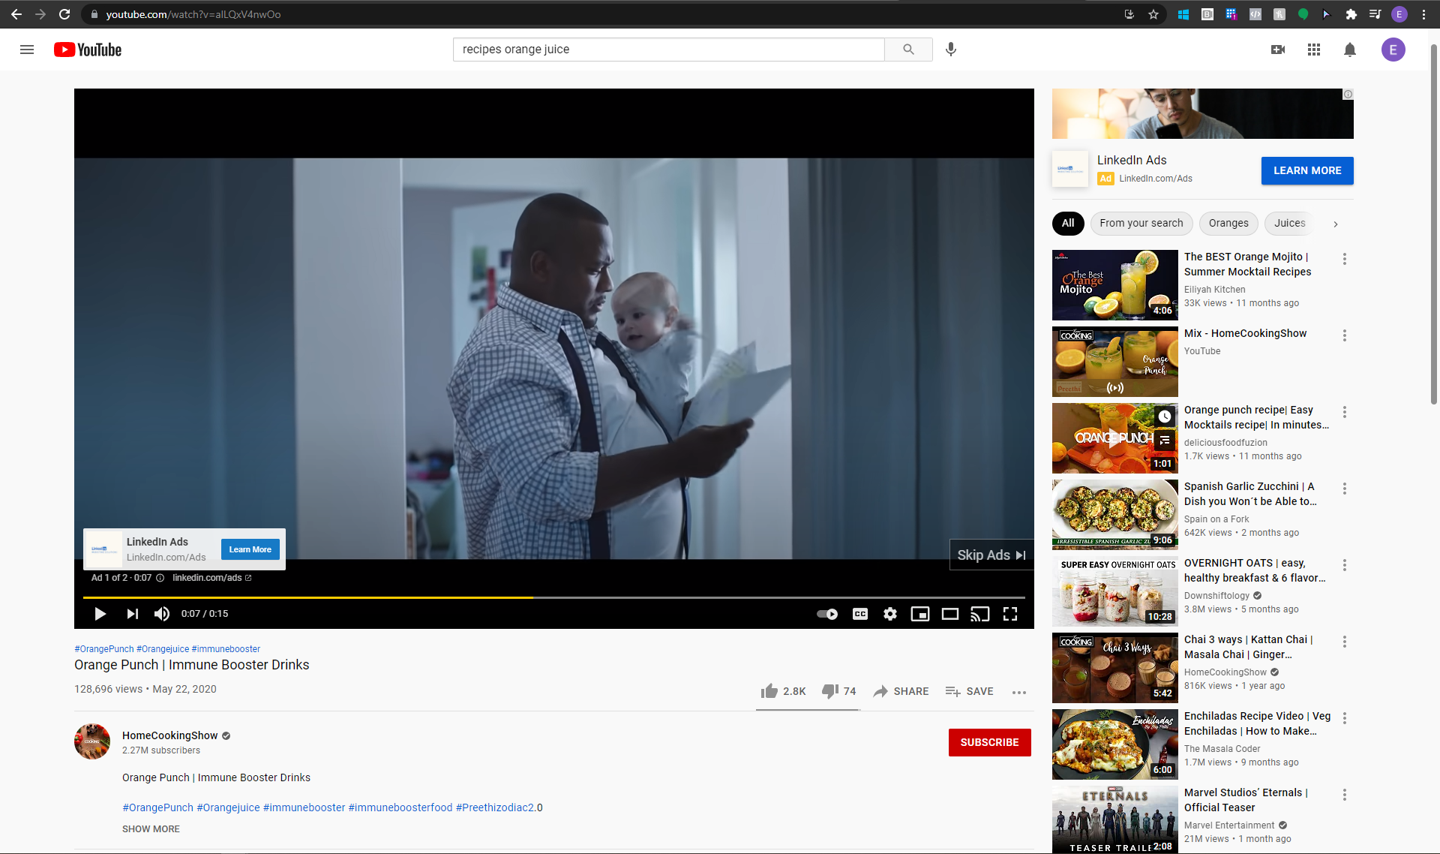

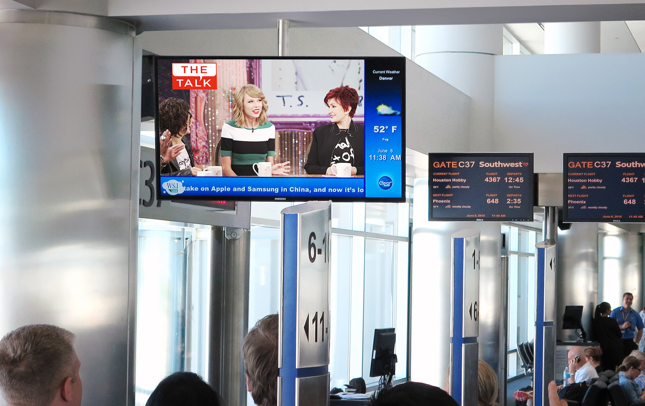
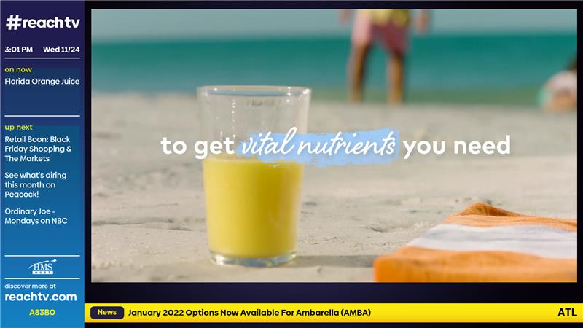
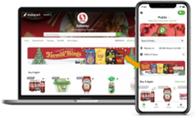
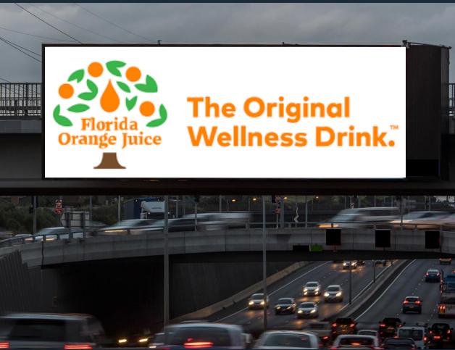
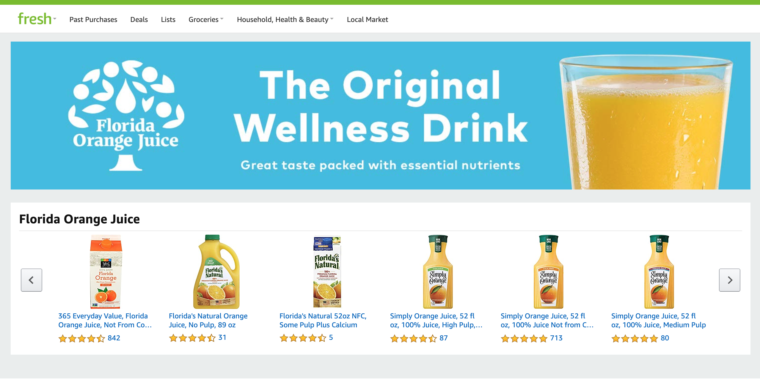


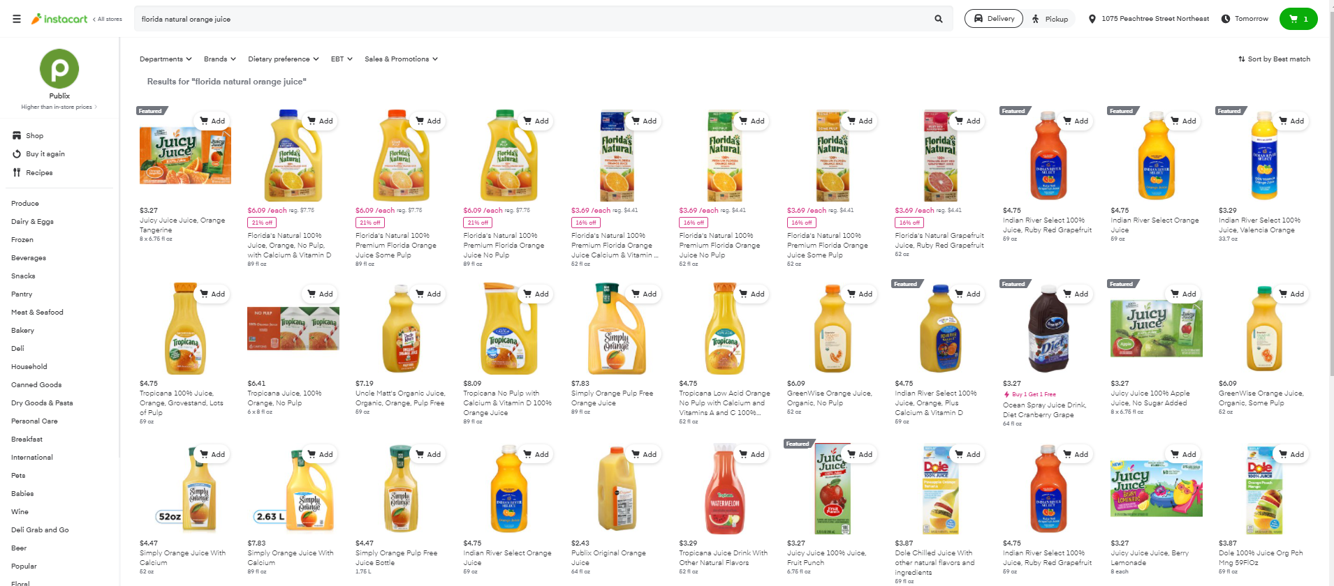
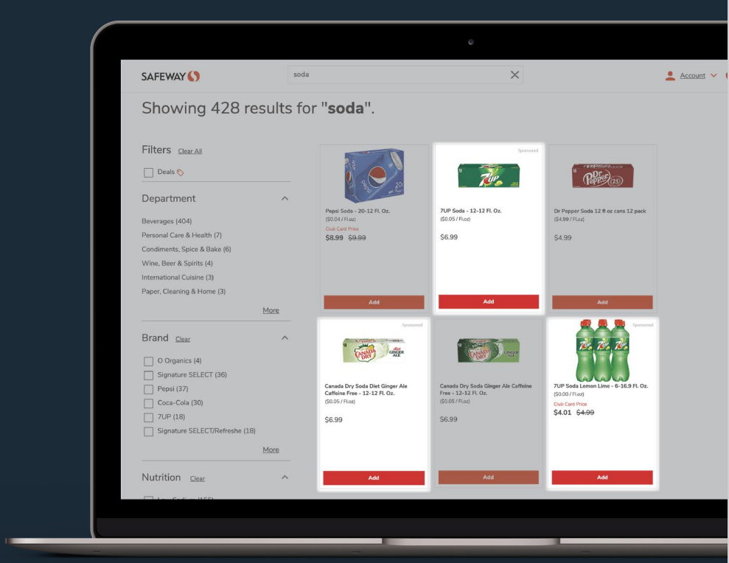
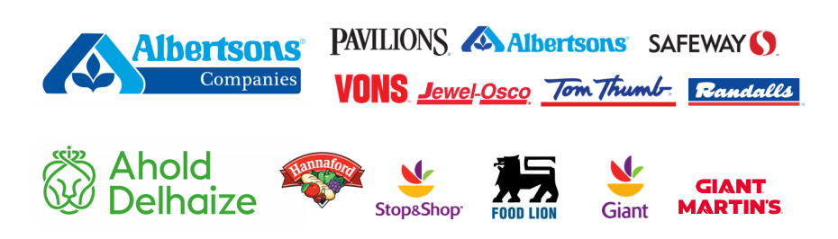

Lapsed Buyer Consumer Journey
Lapsed Buyer
Awareness
Consideration messaging drives to PriceSpider page
Views OTT Ad While Watching Streaming Content
Consideration
Sees Storefront Banner on Retailer Homepage
ReachTV Airport and Digital Billboard Placements
Purchase
On and Off-Site Display with custom pages of
Florida OJ SKUs
Sponsored Search Direct to Cart
Search Keyword Banner
Consideration

Slide 8







Three Types of eCommerce
National Big Box
Regional Grocery
Mobile/Online-First
Large national chains with websites and online grocery ordering
Grocers with highly regionalized and localized presence
Delivery services that are focused on use of mobile ordering and online ordering first
Retailer Specific Customer Data To Identify Lapsed Buyers

Slide 9
eCommerce Partner Performance
$9.40
$37.50
$8.85
$8.60
$2.18
Performance through 1/9/2022
ROAS
ROAS = Return On Ad Spend and is calculated by dividing revenue by spend

Slide 10
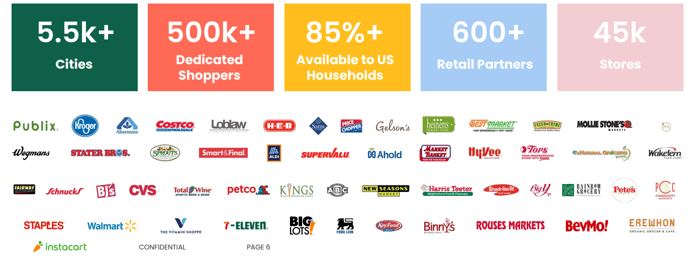
Mobile-First eCommerce
Largest North American Online Grocery Delivery Marketplace

Slide 11







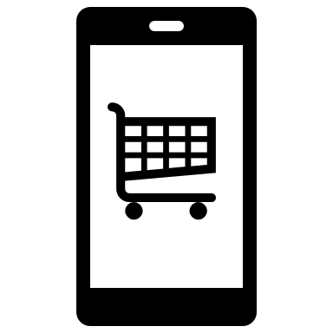
Mobile-First eCommerce
Why Instacart?
Expansive Grocer Selection
Best-in-class Mobile-first experience
Non-OJ Breakfast food & Beverage Searches
The growing future of grocery
When OJ is missing from their online cart
Ability to target the Lapsed Buyer Behaviors

Slide 12

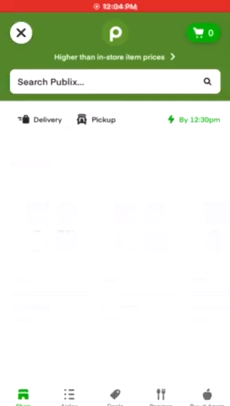
Mobile-First eCommerce
A look at the consumer search experience with our ads.

Slide 13
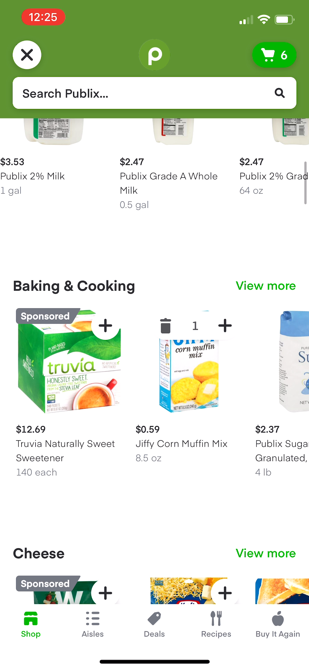
Mobile-First eCommerce
A look at the cart suggestions experience with our ads.

Slide 14
National Big Box eCommerce
National scale drives significant opportunity for sales against lapsed buyers
90%
150MM
#1
#2
Of America shops at Walmart
Customers per week in store & online
Online grocer
eCommerce platform
Data Source: https://www.walmartconnect.com/content/wmg/home/about-us.html

Slide 15







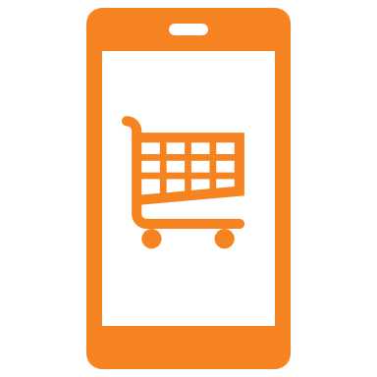
National Big Box eCommerce
Why Walmart?
Access to customer loyalty data
Highest Sales performance to date
Non-OJ Beverage Searches
Expanded pick-up and delivery services
Loyalty data indicating they have not recently purchased
Ability to target the Lapsed Buyer

Slide 16
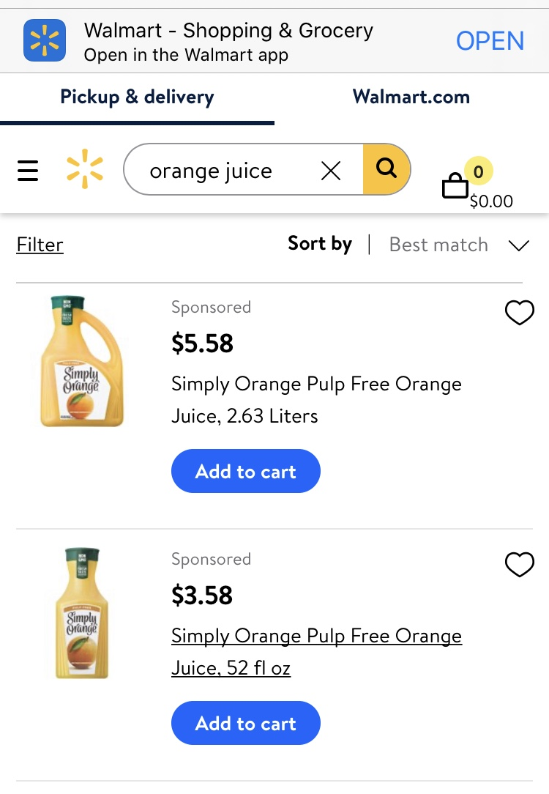
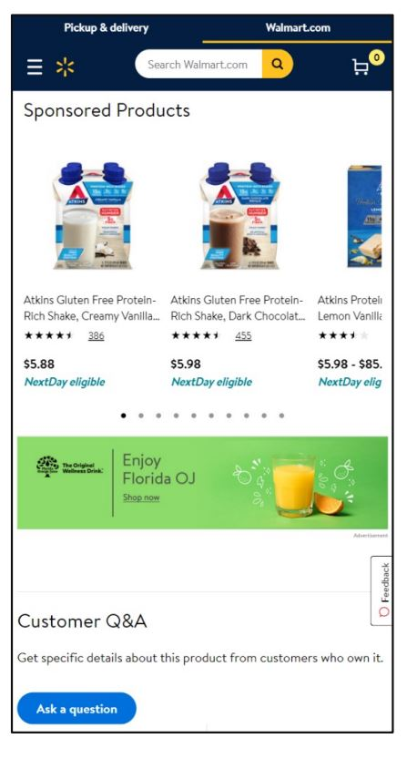
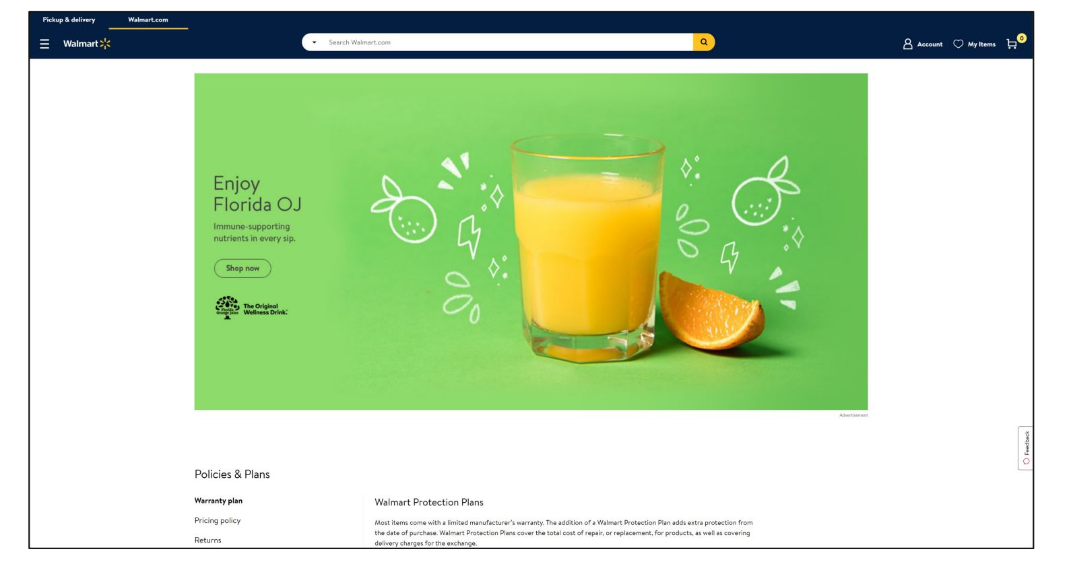
National Big Box eCommerce
A look at the customer experience with our ads
Search
Display
100% Orange Juice

Slide 17

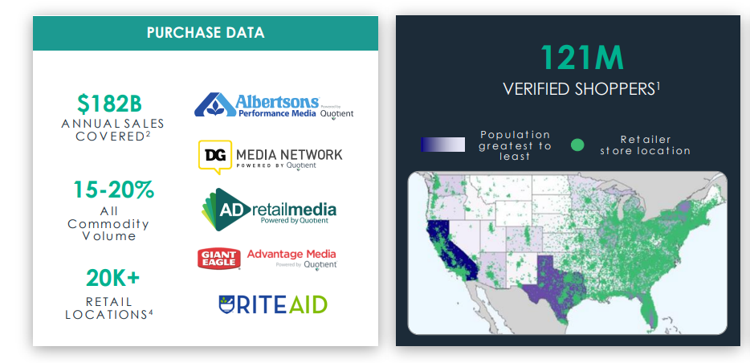
Regional Grocery
Regional grocery partnerships housed under one roof for scale

Slide 18




Regional Grocery
Why Quotient?
Regional Reach with National Scale
+
Connects offline to online tactics
Credit card + Loyalty phone number data
Precise data opportunities
Shopping behavior over last 30 days
Ability to target the Lapsed Buyer

Slide 19
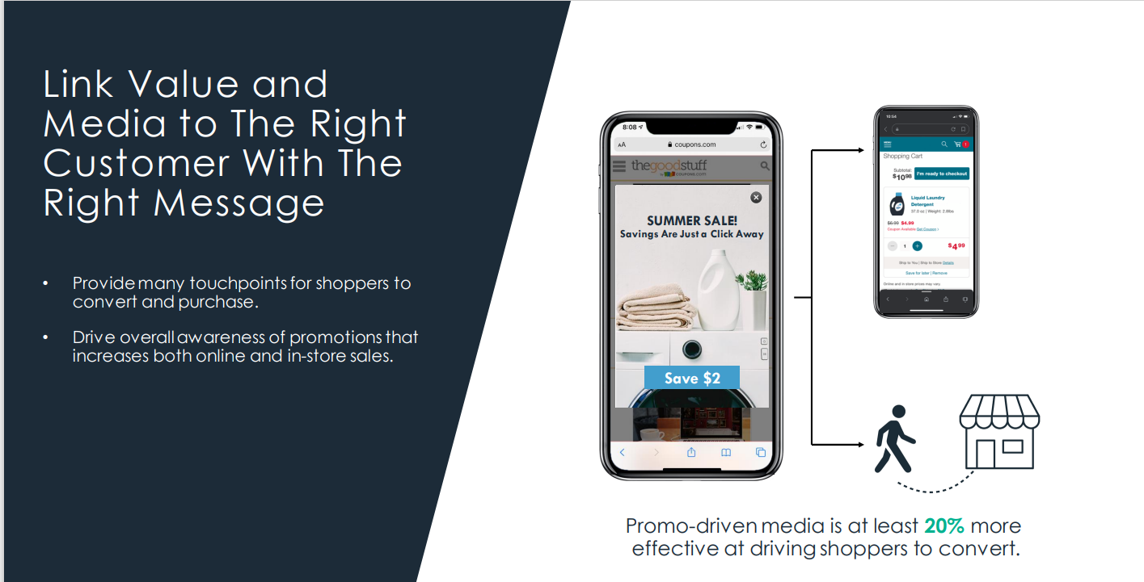
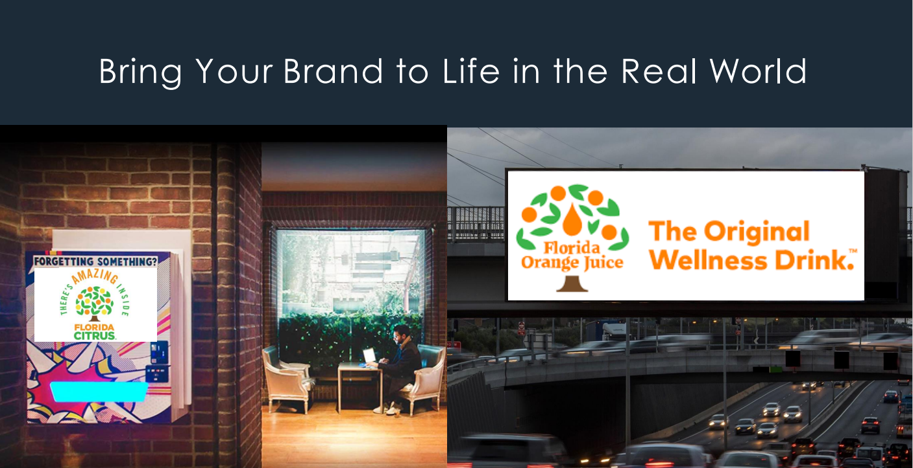
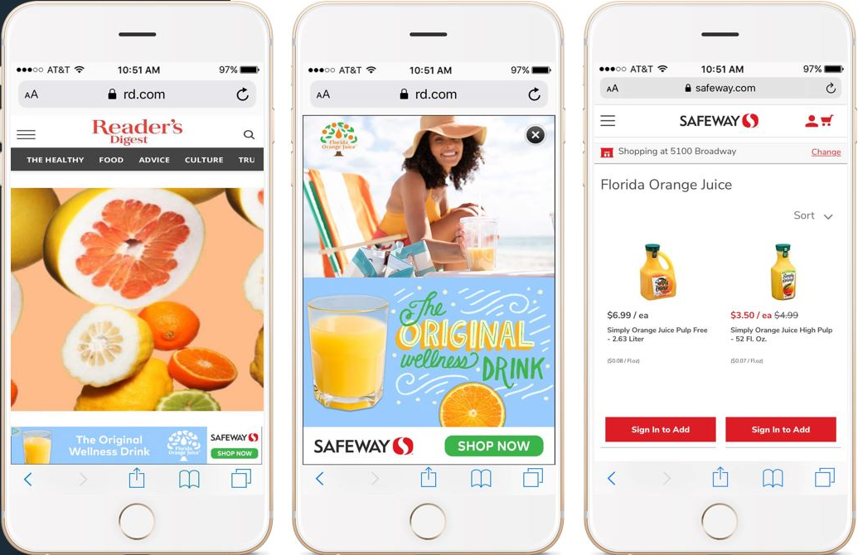
Regional Grocery
A look at the customer experience with Albertsons and Ahold Delhaize, powered by Quotient
Display
Digital Out of Home

Slide 20






Always Optimizing & Being Nimble
A key role in eCommerce campaign management is optimization – constant monitoring of performance across a multitude of channels and nimbly adjusting tactics to maximize FLOJ sales.
Seasonality: throttling spend during FLOJ peak season (calendar Q4)
Shifted from calendar Q2 to Q4
$675K
$500K
$150K
$98K
$25K
$200K
shifted into Search Keyword Banner Ads
shifted into Impulse Ads
shifted into Reach TV airport ads
shifted into goPuff pilot test
shifted into Walmart and Target shopper data-targeted programmatic test

Slide 21
Q&A

Slide 22
Thank you!

